Slide 1
Local Recognition Ceremony
Community

Slide 2
Introducing our Host

Slide 3


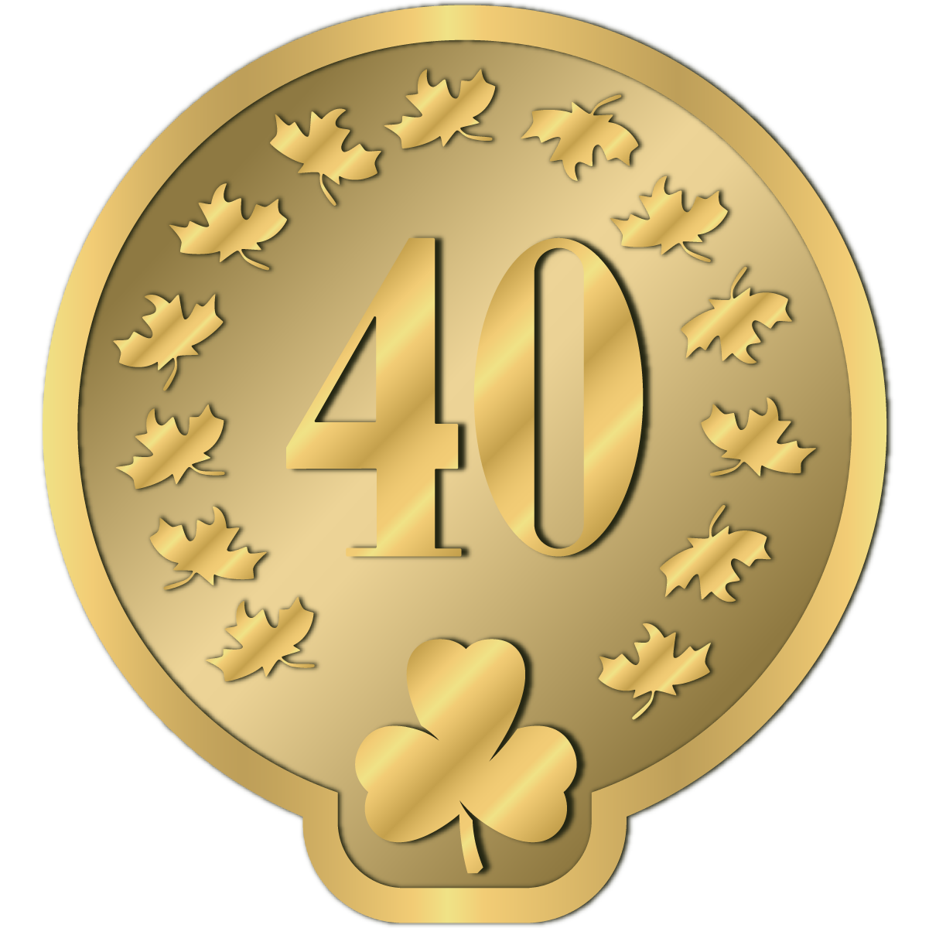
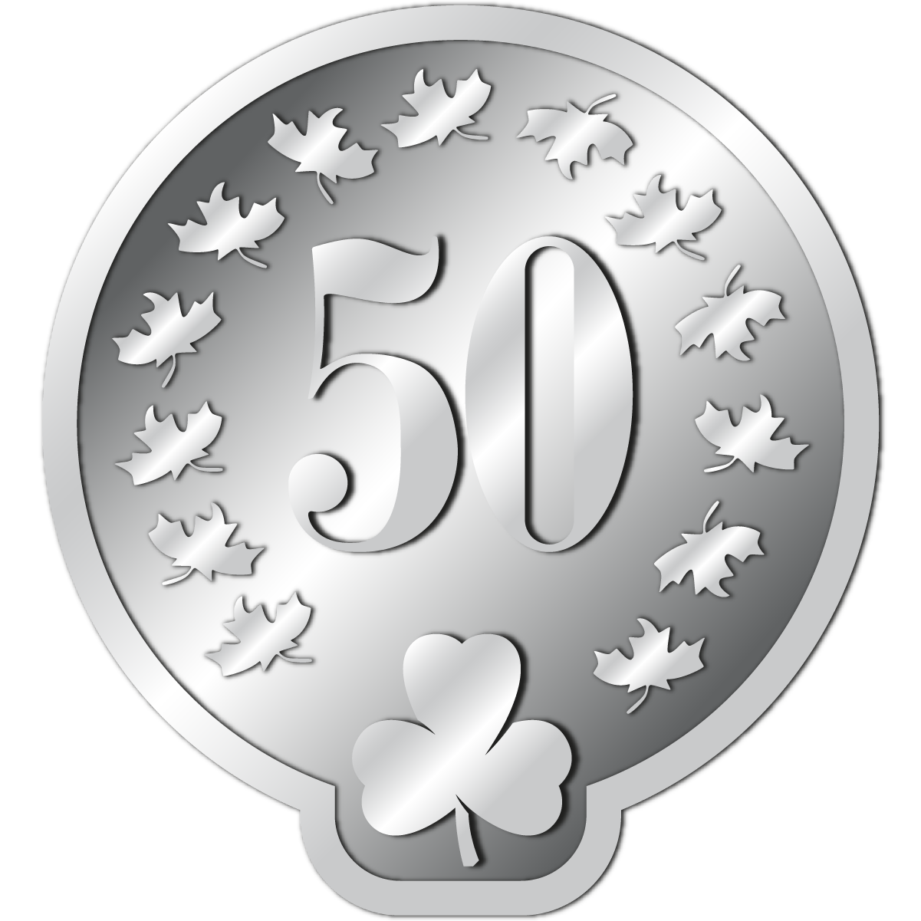



Membership Pin
Girl Guides of Canada membership pins are given to adult members to recognize years of service, with pins provided at five-year intervals.

Slide 4
Membership Pin

Slide 5

Gold Thanks Award
The Gold Thanks Award may be given to a girl or adult member who has contributed to Guiding in a way that deserves thanks. The award is often given for one specific action, but it can also be given for overall good service. Examples could include someone who has completed a short-term role or a term on a committee, someone who led or contributed to a community initiative, or someone who went out of their way to mentor a new Guider.

Slide 6
Gold Thanks Award Recipients

Slide 7

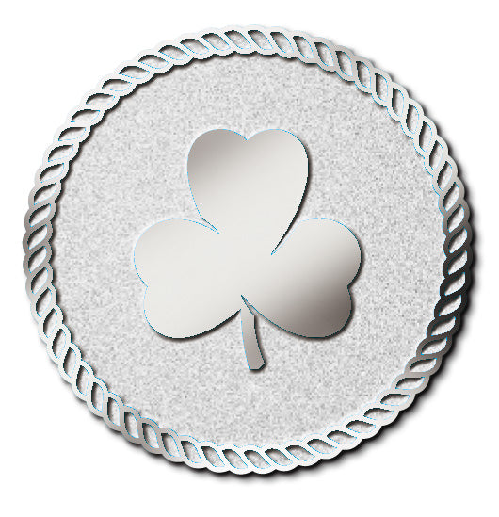
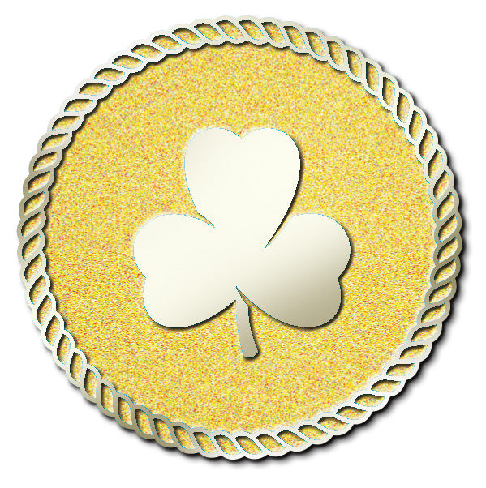
Unit Guider Award (Bronze, Silver, Gold)
UNIT GUIDER AWARD – BRONZE
No minimum
Unit Guider Awards may be presented to members for good service in the role of Unit Guider. Good service is defined as regularly attending meetings, contributing to a unit Guiding team through shared planning and leadership, and providing girls with a range of programming and opportunities.
UNIT GUIDER AWARD - SILVER
4+ years
UNIT GUIDER AWARD - GOLD
11+ years

Slide 8
Unit Guider Award (Bronze, Silver, Gold) Recipients

Slide 9



Merit Award (Bronze, Silver, Gold)
MERIT AWARD PIN - BRONZE
The Merit Award is granted by Ontario Council and is presented to adult Members for service to Guiding above the basic requirements of the position held.
MERIT AWARD PIN - SILVER
MERIT AWARD PIN - GOLD

Slide 10
Merit Award Recipients

Slide 11

Administrative Community Leader’s Award
The Administrative Community Leader Award is granted by Ontario Council and is presented to ACLs who: lead by example; actively welcome new Members and retain current Members; mentor adult Members; uphold the values of GGC; have gained the respect of Members, girls and parents.

Slide 12
Administrative Community Leader’s Award Recipients

Slide 13
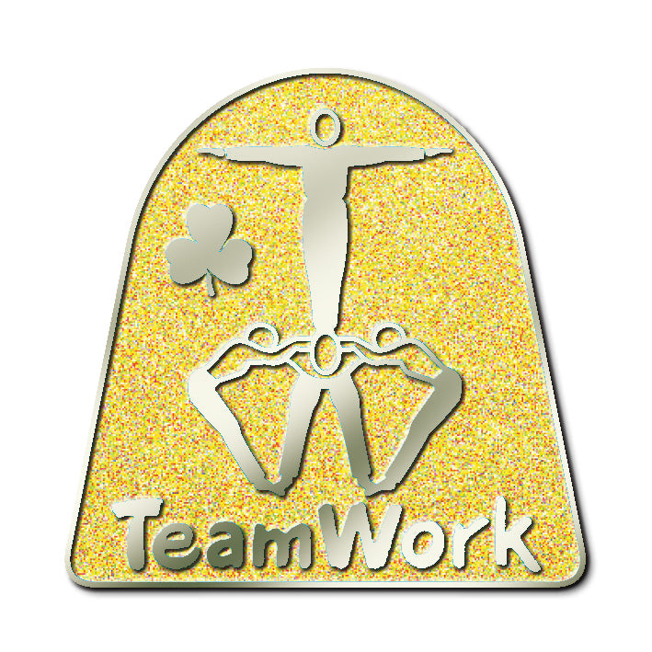
Team Award
The Team Award is granted by the Administrative Community, Trefoil Guild, Specialty Community or Ontario Council and may be given to each Member who planned and carried to completion an extraordinary event or project. The purpose of the Team Award is to give special recognition for the teamwork, creativity, diligence and synergy that go beyond the basic expectations when a group works to produce an event or project. Supporting letters from Members not part of the team are required. Remember it is something “extraordinary” and the description you include should have similar words. This may be awarded to youth or adult Members.

Slide 14
Team Award Recipients

Slide 15
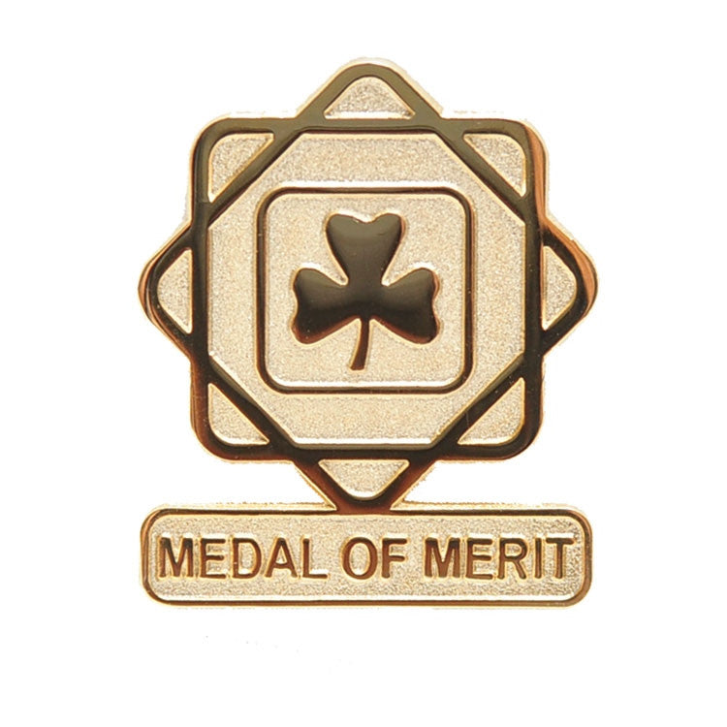
Medal of Merit
The Medal of Merit may be awarded in recognition of service to a significant role or project (e.g., as the lead for a provincial camp, as a member of Provincial Council) or in recognition of significant cumulative service and dedication.

Slide 16
Medal of Merit Recipients

Slide 17

Lady Baden-Powell Award
This award gives girls the opportunity to learn more about Girl Guides and gain a deeper understanding of the global sisterhood of Guiding. The Lady Baden-Powell Award is the highest award a Guide can earn.

Slide 18
Lady Baden-Powell Award Recipients

Slide 19
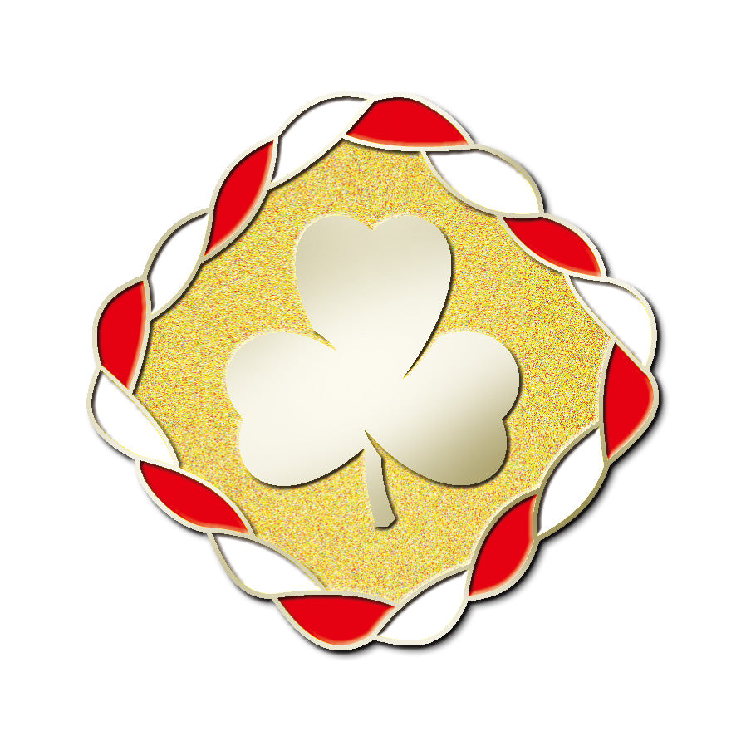
Canada Cord
The Canada Cord encourages girls to meet new people, learn more about themselves and their abilities, and put their leadership skills into action. It is the highest award a Pathfinder can achieve.

Slide 20
Canada Cord Recipients

Slide 21



Trailblazer Leadership Award (Bronze, Silver, Gold)
TRAILBLAZER BRONZE LEADERSHIP AWARD
This prestigious award is the culmination of a Ranger’s work as a youth member. The award recognizes a Ranger’s outstanding achievement and commitment to the Vision, Mission and Values of Girl Guides of Canada. The Trailblazer Leadership Award is the highest award a Ranger can earn.
First year Ranger
TRAILBLAZER SILVER LEADERSHIP AWARD
Second year Ranger
TRAILBLAZER BRONZE LEADERSHIP AWARD
Third year Ranger

Slide 22
Trailblazer Leadership Award (Bronze, Silver, Gold) Recipients

Slide 23

Congratulations to our recipients, and thank you all so much for sharing in the sisterhood of Guiding.

